Slide 1
Natural Farming Approaches in Plant Protection
Dr. G Venkat Raman.

Slide 2
Natural Farming Concept
Healthy Soil
Healthy Family
Natural Farming
Healthy Crop
Healthy Food

Slide 3
Agro-biodiversity
Above ground biodiversity
Crops
Beneficial Insects and Pollinators
Pests
Vertebrate animals ( Birds, Serpents, Grazers etc)
Below ground biodiversity
Microbes ( bacteria, fungi, Protozoa, etc)
Nematodes
Insects
Earthworms
Rodents

Slide 4
Below Ground Biodiversity
There is linkage between Above Ground Biodiversity and Below Ground Biodiversity. Each strain and species of microorganis living in the rhizospehere have great affinity with particular species of plant. This has been coming since long time and part of evolution.
Crops cultivated from desi (Land races or heirlooms) seeds have this type of association with bacteria. That is why the use of desi varieties is much relevant in the natural farming
Below Ground Biodiversity plays major role in soil fertility.
95% of the biodiversity lives inside the soil. But only 3% of organisms are characterized.
The food web is starting from microorganisms and ending with soil dwelling mammals.
Below ground biodiversity is 10 time more than that of above ground biodiversity. Science has strong evidence that microbes such as Mycorrhizal fungi and Plant Growth Promoting Rhizobacteria (PGPR) help plants to deal with biotic and abiotic stress through plant growth promotion and induced resistance. Belowground microbes interact with above ground biodiversity such as plants(herbivore insects, their natural enemies and pollinators), in a bidirectional way.
Beneficial soil organisms perform many beneficial functions which influence soil fertility and plant health. Beneficial bacteria release organic acids which are useful in solubilization of mineral elements of the soil. Bacteria also release complex polysaccharides that support in making of soil aggregates. Soil aggregates give soil to structure.
Other beneficial soil microorganisms such as the Actinomyces release antibiotics into the soil. These antibiotics are taken up by the plant to protect it against pests.
Fungi perform beneficial functions in soils. Mycorrhizal fungi supply trace elements and water to plant roots. Other fungi decompose crop residues and vegetative organic matter and release nutrients. Many of the organic compounds released by fungi help in the formation of humus and soil aggregates.
Beneficial soil dwelling animals create tunnel like channels in the soil which are source for water percolation and air circulation. Soil dwelling animals also help in the formation of humus and balance the concentration of soil microorganisms within the food web. Thus, a living soil is a fertile and healthy soil.

Slide 5
Plant Immunity
Plants have developed direct defence against insect herbivores and indirect defence to promote the effectiveness of natural enemies of insect herbivores.
Soil borne microbes (eg. Root endophytic fungi, mycorrhizal fungi, plant growth promoting fungi, rhizobacteria and rhizobia) exert positive effects on plant growth and survival through direct and plant mediated mechanisms.
Plant defence mechanisms by plant growth promotion and Induced Systemic Resistance (ISR) is developed in Natural Farming.
PGPR favor plant growth notably by facilitating nutrient availability and modulating the host’s hormonal balance but also display plant protective activity toward pathogen ingress.
This biocontrol potential relies on several traits including the ability to efficiently compete for space and nutrients with pathogens, a strong direct antagonistic activity based on secretion of low-size antimicrobials or hydrolytic enzymes and the capacity to stimulate induced systemic resistance (ISR).
ISR is a systemically expressed resistance state that renders the host less susceptible to subsequent infection, and it is of great interest from an agronomical perspective because effective against a broad spectrum of microbial pathogens, nematodes, and insects.
Most of the well-characterized PGPR elicitors are soluble compounds, but some volatile organic compounds (VOCs) were as well-reported to induce systemic resistance in the host plant, showing that these metabolites can also act as infochemicals involved in inter-kingdom communication

Slide 6
PGPR Induced Immunity in Rice Plants Ref: Mohamad Syazwan Ngalimat et al Microorganisms 2021, 9(4), 682
Biological control interactions exerted by the plant growth-promoting bacteria (PGPB). This illustration depicts the interactions between PGPB, phytopathogens, and plants. PGPB promote plant growth either by direct and or indirect mechanisms. PGPB colonize plant’s rhizosphere and produce antimicrobial metabolites. In the plant’s rhizosphere, antibiosis and nutrient competition interaction suppresses the growth of phytopathogens. Elicitors of induced systemic resistance (ISR) production by PGPB and in the simultaneous presence of phytopathogens enhanced the plant ISR. Thus, this mediated defense response of plants towards phytopathogens and consequently enhanced plant growth and health

Slide 7
Insect Pests and Management Approaches in Natural Farming

Slide 8
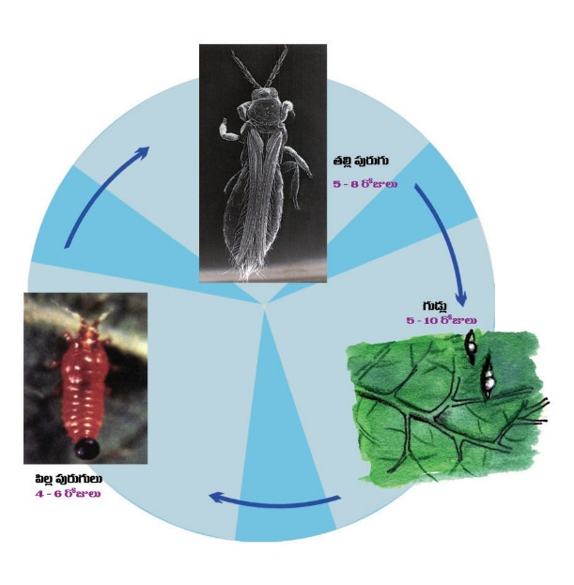
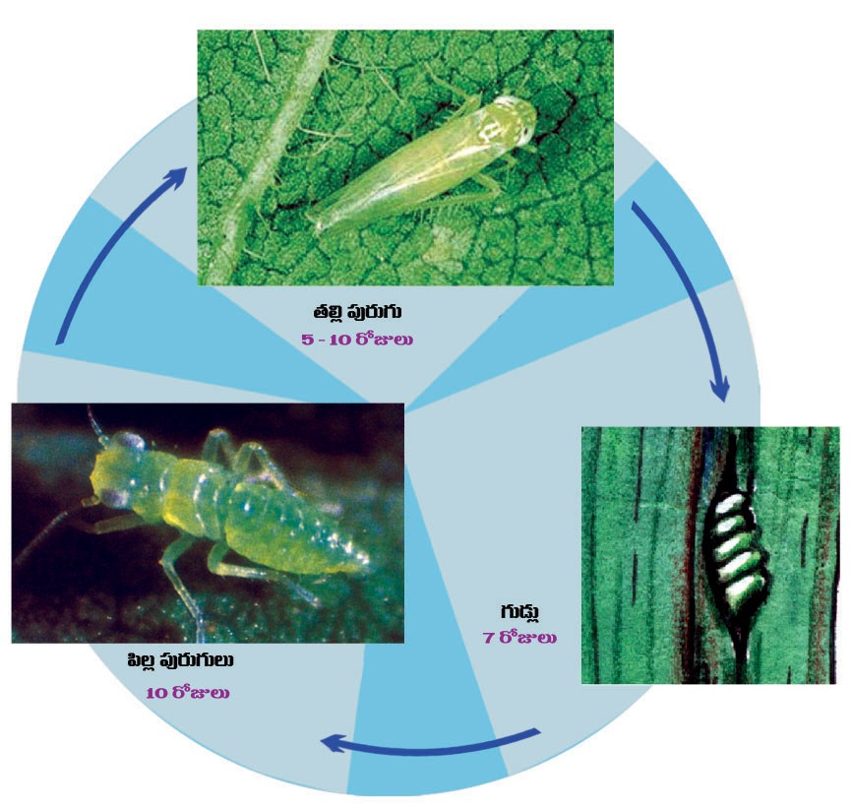
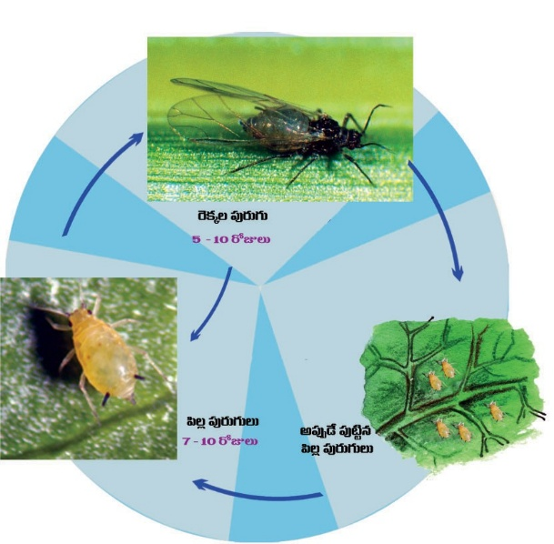
Sucking Pests and Their Life cycles( Whitefly, Thrips, Jassids, Aphids)

Slide 9
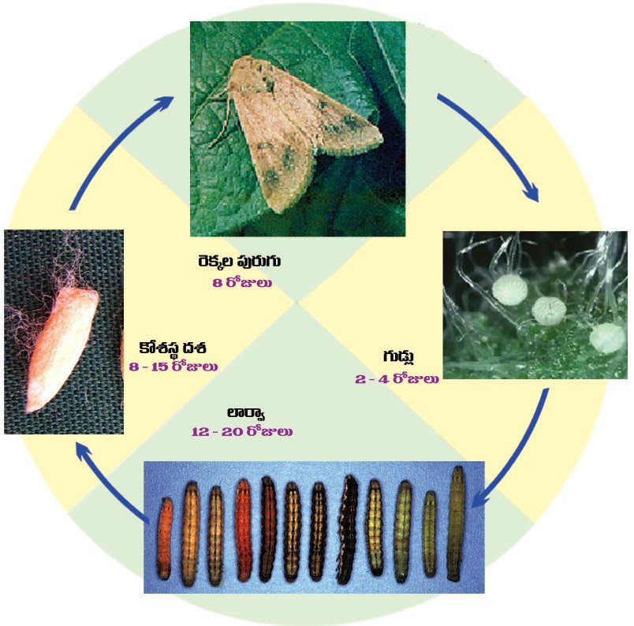
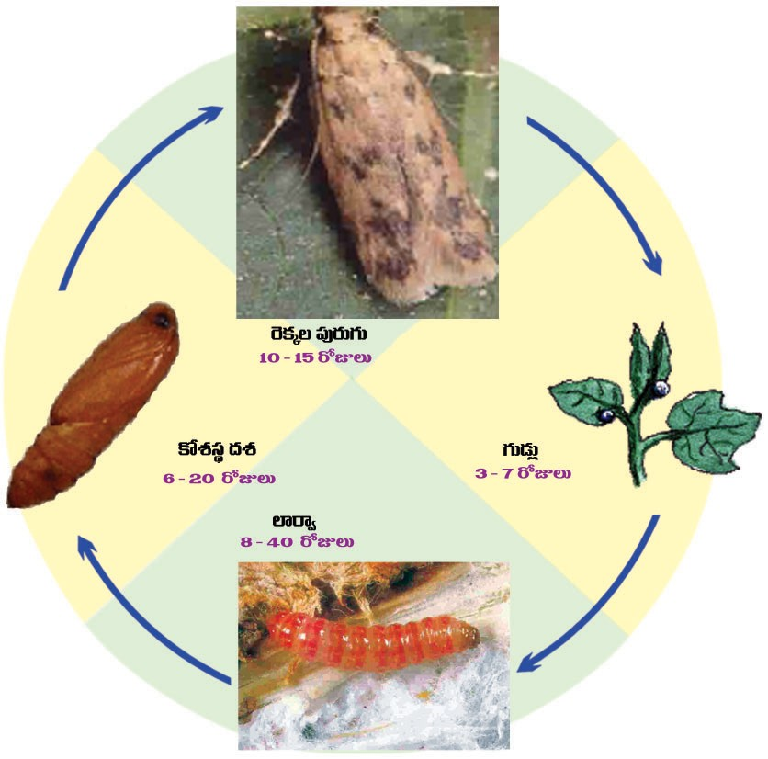
Lepidopteran pests and Their Life cylces ( Tobacco Cutworm, American Bollworm, Pink Bollworm)

Slide 10
Insect Pests and Management Approaches
Preventive Approaches
Seed Treatment with Beejamruth
Spraying of Panchagavya ( Both Growth promoter and pest and disease resistant)
Push-pull strategy by Crop diversity
Border crops
Trap crops
Yellow , white, Blue sticky plates
Light traps
Pheromone traps
Bird perches
Curative
Spraying of Neemastra, Agnastra, Brahmastra, Dashaparni etc.

Slide 11
Seed Treatment with Beejamruth
Ingredients
Water – 20 ltrs
Desi Cow dung - 5kgs
Desi Cow urine - 5 ltrs
Edible Calcium - 50 grams
5. Bund Soil - 200 gram
Preparation method
Take a Plastic Drum/ Mud Pot/ Iron Drum/ Cement Drum: Mix all the above stated ingredients by stirring it with a wooden stick in clockwise direction. Soak the solution overnight. Next day morning filter it with a nylon cloth and it can be used for seed treatment
Shelf Life: 48 hours.

Slide 12
Beejamruth-Benefits and Usage
Benefits
Kills all disease causing spores of seed born diseases
Kills insect eggs associated with seeds
Induce germination , terminates hibernation
Uniform Germination
Healthy crop
Usage:
1) For Trees, Remove the plastic cover and dip the sapling along with soil material or if the soil material is loose, pour the Beejamrutham into the soil material before removing the plastic cover and wait for 30 minutes before planting it in the field.
2) Cereals, Millets, all seeds of Gramineae family , Dicot Pulses, Leguminous family seeds, All vegetable seeds, spread the seeds on a plastic sheet and delicately spray the Bheejamrutham on them and delicately rinse them with hands such that their outer layer doesn’t get spoiled. Let them dry in the shade for 30 mins and then can be sown
3) Saplings, seedlings: Dip the roots in Bheejamrutham , wait for 15 to 30 mins and then can be planted.
4) Tubers, Cuttings: Dip them in Bhejamrutham, remove them and dry them in shade for 15 to 30 mins and then can be sown.

Slide 13
Neemastra
Ingredients
Water - 200 litres
Desi Cow Urine - 10 litres
Desi Cow Dung – 2 kg
Neem leaves with tender stems – 10 kg
Preparation Method
-Grind the leaves and tender stems. Take water into a drum and mix all the ingredients.
-Stir the solution with a stick in clockwise direction for 10 mins and cover the drum with a gunny bag/Lid.
-Allow it to ferment for 48 hours. Stir it at every 12 hours. Filter it with nylon/muslin cloth and store it in a clean vessel
-Don’t expose it to Sun light. Shelf life :- 6 months after RTU
Recommended for
-All sucking pests
-Small caterpillar Prophylactic method. Antifeedant, Ovicidal

Slide 14
Agniastram
Ingredients
Desi Cow Urine - 20 litres
Neem Leaves (Ground thoroughly) – 2 kg
Tobacco Powder - 0.5 kg
Red chilli powder - 0.5 kg
Garlic paste - 0.25 kg
Preparation method
Put all the ingredients in to iron/steel vessel, stir it well and boil the solution till it foams out, then decrease the heat or stir it and in few seconds, it foams out again. Like that its repeated for four times totally. Let it cool down and keep in a cool dry place for 48 hours without opening the lid (only lid, no gunny bags). Stir it every 12 hours without opening the lid for a minute. After that filter it and store it in a clean vessel.
Shelf life: 3 months
Usage: 5% Agneyathram on Borers, Bollworms, big and hiding caterpillars, Thrips.

Slide 15
Brahmastra
Ingredients:
1. Desi Cow urine - 20 ltrs
2. Neem Leaves - 2kg
3.Pongamia leaves - 2kg
4.Custard apple leaves -2kg
5. Castor leaves - 2kgs
6. Datura leaves - 2kgs
Preparation Method
Hand grind all the leaves like chutney. Don’t use grinders. Put all the ingredients into iron/steel vessel, stir it well and boil the solution till it foams out, then decrease the heat or stir it and in few seconds, it foams out again. Like that its repeated for four times totally. Let it cool down and keep in a cool dry place for 48 hours without opening the lid (only lid, no gunny bags). Stir it every 12 hours without opening the lid for a minute. After that filter it and store it in a clean vessel preferably an earthen pot.
Shelf life: 6 months
Usage: 5% Brahmastram on All sucking pest, Caterpillars, Thrips (but not the hiding ones).

Slide 16
Dashaparni
Ingredients
1) Water - 200 litres
2) Desi cow urine - 10 litres
3) Desi cow dung – 2 kg
4) Take 10 Types of Leaves out of the following 22 types of Leaves.
(Note: 1st Five types of leaves are mandatory).

Slide 17
Dashaparni
Neem leaves - 3 kg Leaves of Pongamia pinnata) - 2kgs
Leaves Annona sqamosa- 2kgs Castor leaves (ricinus communis) - 2kgs
Datura leaves ( Datura metel)- 2kgs Leaves of Calatropis procera - 2kgs
Leaves of Vitex negundo - 2kgs Leaves of Datura stramonium - 2kgs
Leaves (Nerium indica)- 2kgs Leaves of Hibiscus rosa - 2kgs
Mango leaves (Mangifera indica) - 2kgs Leaves Lantana camara - 2kgs
Leaves of Casia tora - 2kgs Leaves of Guava (Psidium guava) - 2kgs
Leaves of Pomegranate, (Punica granatum) - 2kgs Leaves of Drumstick (Moringa oleifera) – 2kgs
Leaves of Coffee (Coffea arabica) - 2kgs Leaves of Mahua (Maduca indica) - 2kgs
Coco leaves (Theobroma cacao) - 2kgs Leaves of Acacia nilotica - 2kgs
Leaves of Psoralea corylifolia - 2kgs Leaves of Bitter Gourd (Momordica charantia - 2kgs

Slide 18
Dashaparni
Preparation Method
First take the grounded leaves of ten types and mix them in water. Soak them over night. Next day morning mix Grounded Basil leaves, Grounded Marigold leaves, Turmeric powder, Ginger powder, Tobacco powder, Green chilli paste, Garlic paste into that solution. Stir it well with a wooden stick and keep the lid. Keep the solution in shade for 40 days. Keep stirring every 12 hours for a minute. We can use it after 40 days.
Shelf life: 6 months.
Usage: Spray 4% Dasaparni kashayam whenever necessary on all kinds of pests.

Slide 19
Crop Diseases and Management options in Natural Farming

Slide 20
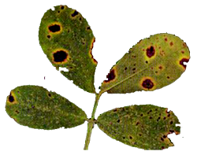
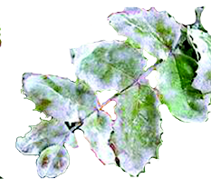
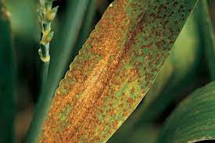
Diseases (Alternaria leaf spot, Tikka leaf spot, Powder mildew, Rust)

Slide 21
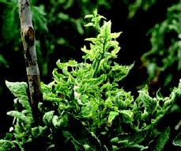
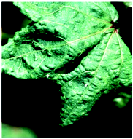
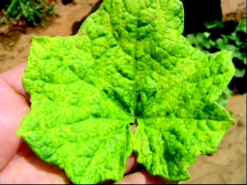
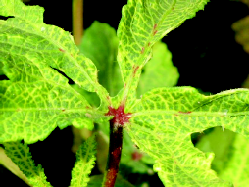
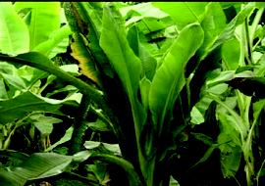
Virus disease (Yellow Mosaic in Bendi, Leaf Curl and Little leaf in Brinjal )

Slide 22
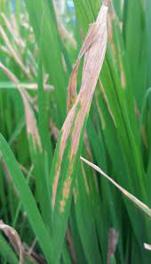
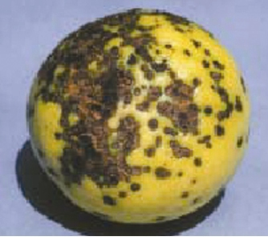
Bacterial diseases ( Speck in Tomato, Anthracnose in Guava, BLB in paddy

Slide 23
Disease Management Approaches
Preventive Measures
Selection of Healthy seeds
Selection of disease resistant varieties
Seed treatment with Beejamruth
Adjust sowing time
Crop diversity with Boarder crops and Inter crops
Mulching
Frequent sprinkling of Drava Jeevamruth on mulch material, as to increase diversity and numbers of useful bacteria in soil.
( Useful bacterial prevent spread of diseases and induce immunity in plants)
Curative Measures
Spraying of Sour butter milk and Dry Ginger + Milk solution

Slide 24
Sour Buttermilk
Ingredients:
1. Water - 200 liters,
2. Fermented sour Buttermilk - 6 liters
Preparation Method
Take 6 liters of milk and make curds with it. Remove the Creamy layer on it. Let it remain for 3 to 5 days, so there will be a grey layer of fungus formed . Churn it well and mix in water , filter and spray on infected trees.
Shelf Life : 3 days
Usage: Works against all diseases

Slide 25
Dry Ginger and Cow milk solution
Ingredients:
1.Water - 2 ltrs,
2.Ginger Powder - 200 grams,
3.Desi (native) cow milk -2ltrs.
Preparation Method:
Take ginger powder and mix it in water. Boil the solution till it becomes half by volume and let it cool. Take Desi cowmilk in a bowl and boil it and remove the cream. Let it cool. Mix both solutions and stir it well with a wooden pole. After 2 hours you can use it.
Shelf life: 48 hours.
Usage: Works against diseases . Spray 5% solution on infected parts of crop/ trees.

